Slide 1
DisInformationDetector by Valkyrie-2

Slide 2
DisInformationDetector
by valkyrie–2

Slide 3
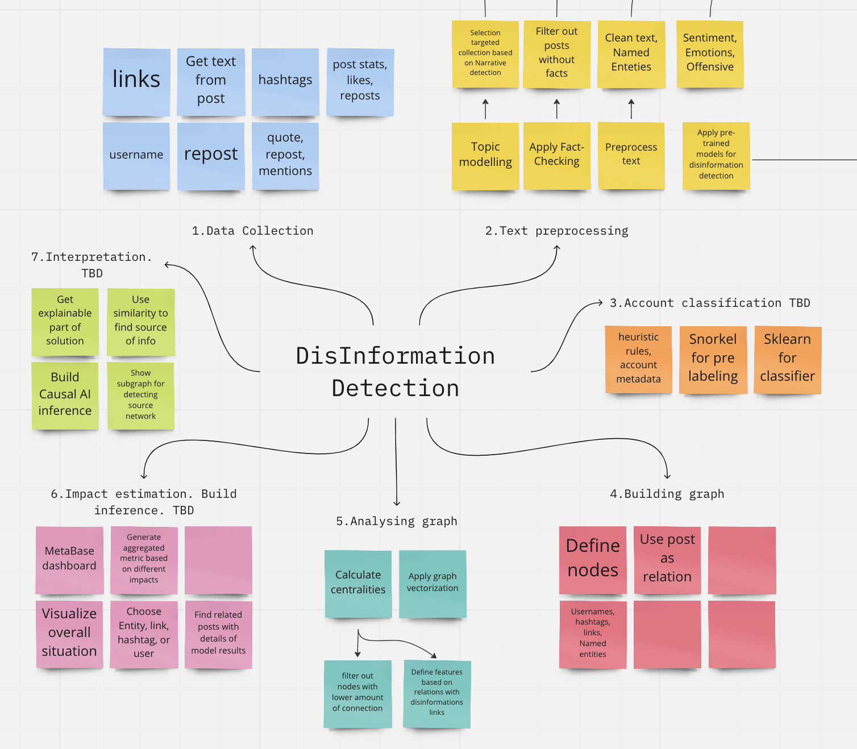
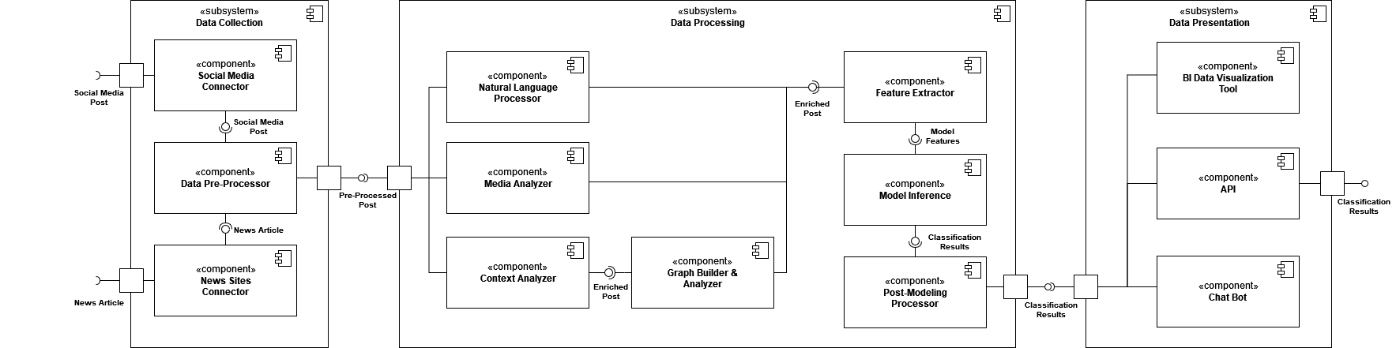
DisInformation Detector
Process flow with details
DisInformation Detector is a machine learning-based system designed to identify dis/misinformation in social media, including:
Extraction of metadata/features from text data by applying ML models
Unveiling hidden relations with Neo4j graph DB
Storing metadata for analytic purposes in PostgreSQL DB and building the final ML model
Interpretability via BI reports to answer the WHY questions

Slide 4
Description
DisInformation Detector is a machine learning-based system designed to identify dis/misinformation in social media. It uses a state-of-the-art model built using:
Various feature generation techniques, such as sentiment and emotional analysis, named entity recognition, and claim checking
Pre-built Transformer-based models from Hugging Face
Graph analytics in Neo4j
It has a visual dashboard based on Metabase (an open-source BI data visualization tool).
Using graph algorithms such as centralities reveals hidden dependencies via external links and hashtags, identifies influential users and posts, and connects different disinformation "communities".
By combining diverse feature-generation techniques with machine learning algorithms and graph database technologies, DisInformation Detector can detect patterns of disinformation in social media data and generate alerts and reports for further investigation. The system is designed to be highly scalable, flexible, and interoperable, making it suitable for use in a wide range of applications and settings.

Slide 5
DisInformation Detector
EXTRACTION OF METADATA/FEATURES FROM TEXT DATA BY APPLYING ML MODELS
UNVEILING HIDDEN RELATIONS WITH NEO4J GRAPH DB
@JoeBiden is a coward and his administration! They want this war and are encouraging Putin to invade! A president with a brain would have sanctions in place against Russia!! If Biden puts a sanction in place it will be LAME LAME AND BE TOTALLY INEFFECTIVE! Get this coward out!
PROVIDING INTERPRETABILITY VIA BI REPORTS TO ANSWER THE WHY QUESTIONS
COLLECTING METADATA AND BUILDING THE FINAL ML MODEL

Slide 6
High-level Architecture Steps
INTERPRETATION
DATA COLLECTION
Get explainable part of solution
Build Causal AI inference (TBD)
Use a similarity to find source of information (TBD)
Show a subgraph for detection source tracing (TBD)
Links
Get text from post
Hashtags
Post stats
Likes
Reposts
Username
Quotes
Mentions
BUILD INFERENCE & ESTIMATE IMPACT
TEXT PREPROCESSING
Generate aggregated metrics based on different impacts
Visualize broad context
Choose an entity, link hashtag, or user
Find related posts with details of model results
Topic modelling
Apply claim-checking
Preprocess text
Apply pretrained models for disinformation detection
Select targeted collection-based on Narrative detection
Filter out text without facts
Clean text, detect Named entities
Get Sentiments, Emotions, Offensive
ACCOUNT
CLASSIFICATION (TBD)
ANALYZING GRAPH
Heuristic rules, account metadata
Snorkel for pre-labeling
Sklearn for classifier
Calculate centralities
Apply graph vectorization (TBD)
Filter out nodes with low amount of connection
Define features based on relations with disinformation links
BUILDING GRAPH
Define nodes for users, hashtags, links, named entities
Use post as relation

Slide 7
Used Technologies
PYTHON
SPACY
HUGGING FACE
CLAIMBUSTER
Used for custom scripts and apps to detect disinformation, automate data processing, build ML models, and create data visualization tools.
Detects disinformation using NLP tasks, such as named entity recognition, dependency parsing, and text classification. Its features identify entities and relationships between words in text.
Provides pre-trained models and tools for natural language processing, including sentiment analysis and text classification. These tools can be used to identify the emotional tone, intention, and veracity of text, making them useful in detecting disinformation.
Is the umbrella term for all fact-checking related projects. It started as an effort to create an AI model that could automatically detect claims worth checking. Since then, it has steadily made progress towards the holy grail of automated fact-checking.
GENSIM
POSTGRESQL
NEO4J
METABASE
Is a library for topic modeling and document similarity analysis, which can be used to identify similarities and patterns in large volumes of text. By analyzing
the similarities between documents and topics, Gensim can help identify potential cases of disinformation and trace their sources.
Is a database management system that can be used to store and query large volumes of text and metadata, such as information about the sources and authors of documents. By using PostgreSQL to store and manage data, analysts and
researchers can more efficiently identify and analyze potential cases of disinformation.
Is a graph database that can be used to model and analyze complex
networks, such as those involved in the spread of disinformation. By using Neo4j to visualize and
analyze the relationships between different entities, such as people, organizations, and topics, analysts and researchers can gain valuable insights into the sources and spread of disinformation.
Is a business intelligence and
data visualization tool that can be used to create custom dashboards and reports for analyzing data
related to disinformation. By using Metabase, analysts and researchers can more easily visualize and share data insights, making it easier to detect and analyze potential cases of disinformation.

Slide 8
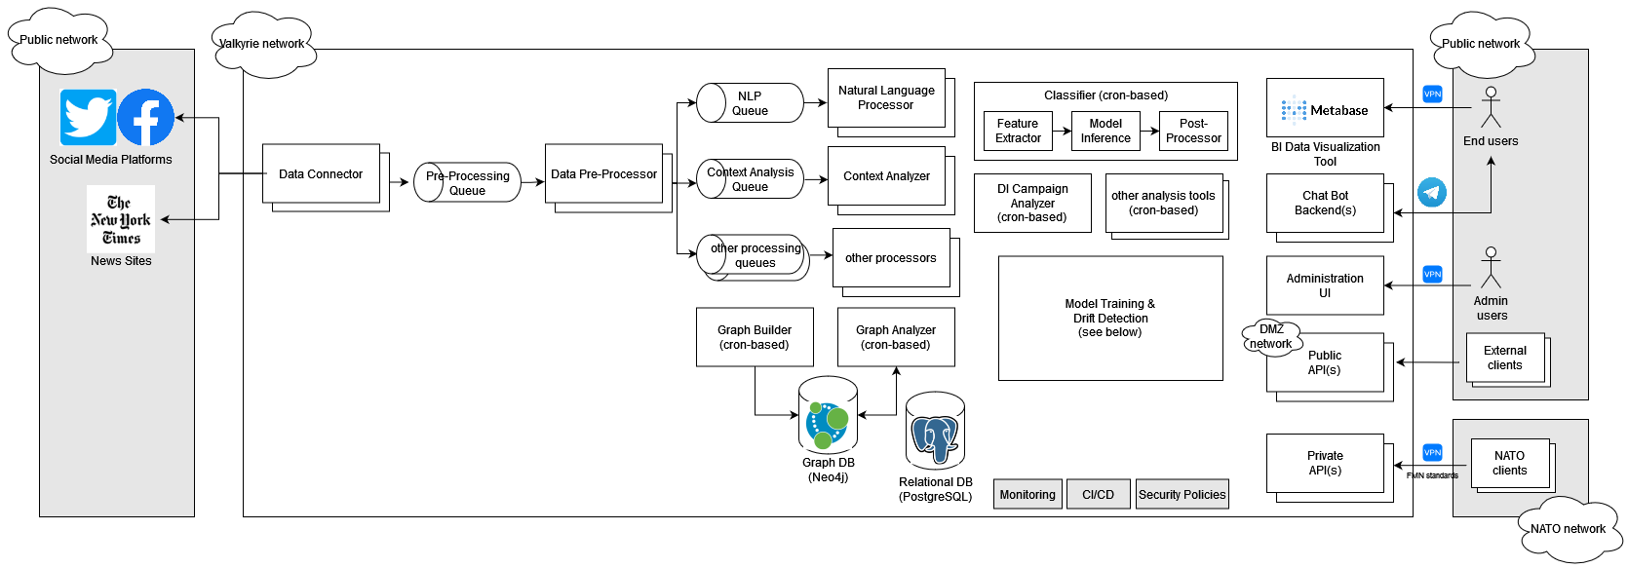
Deployment Diagram

Slide 9
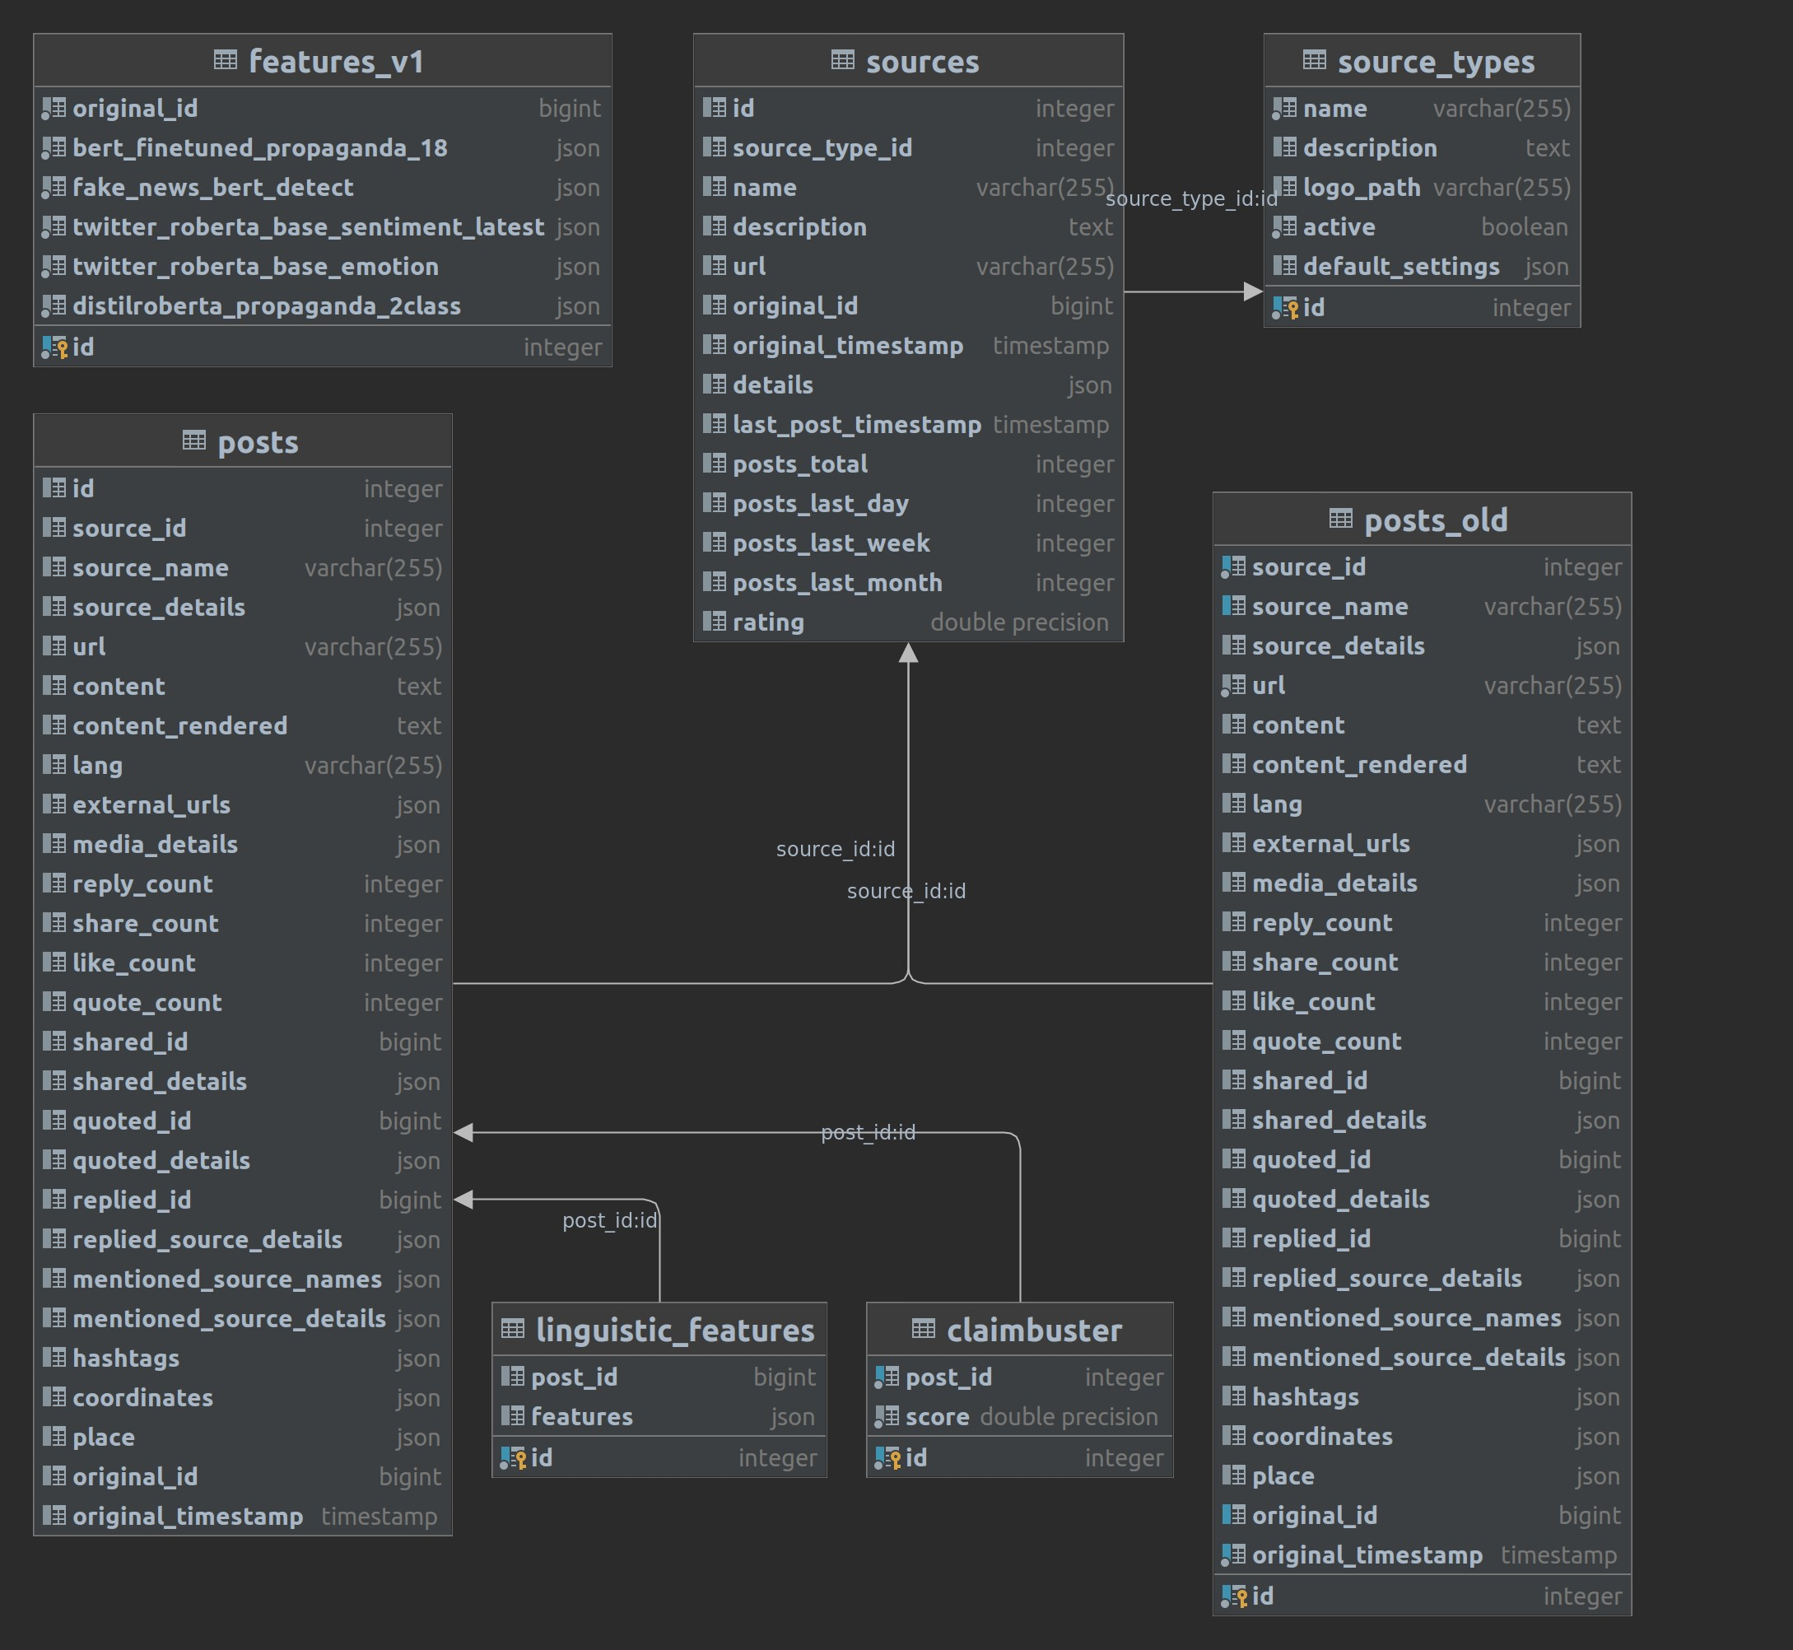
Scheme in PostgreSQL

Slide 10
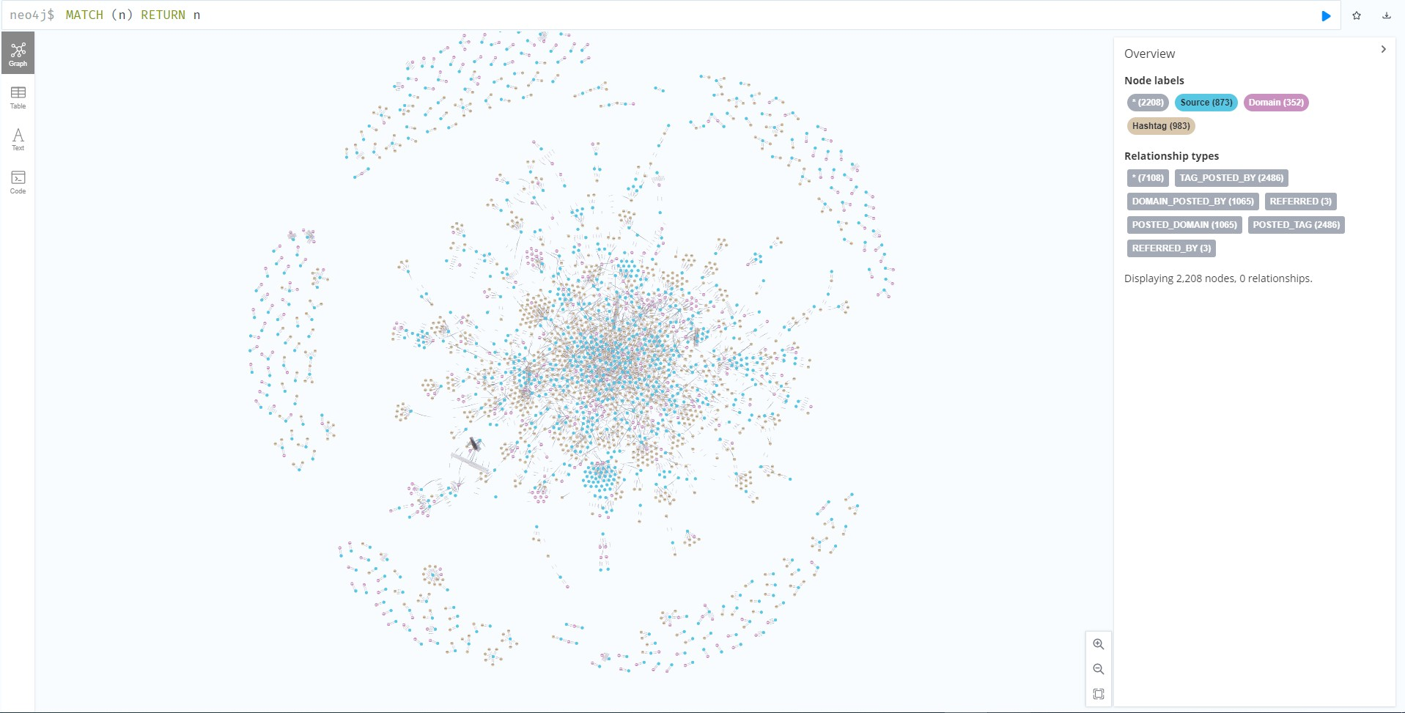
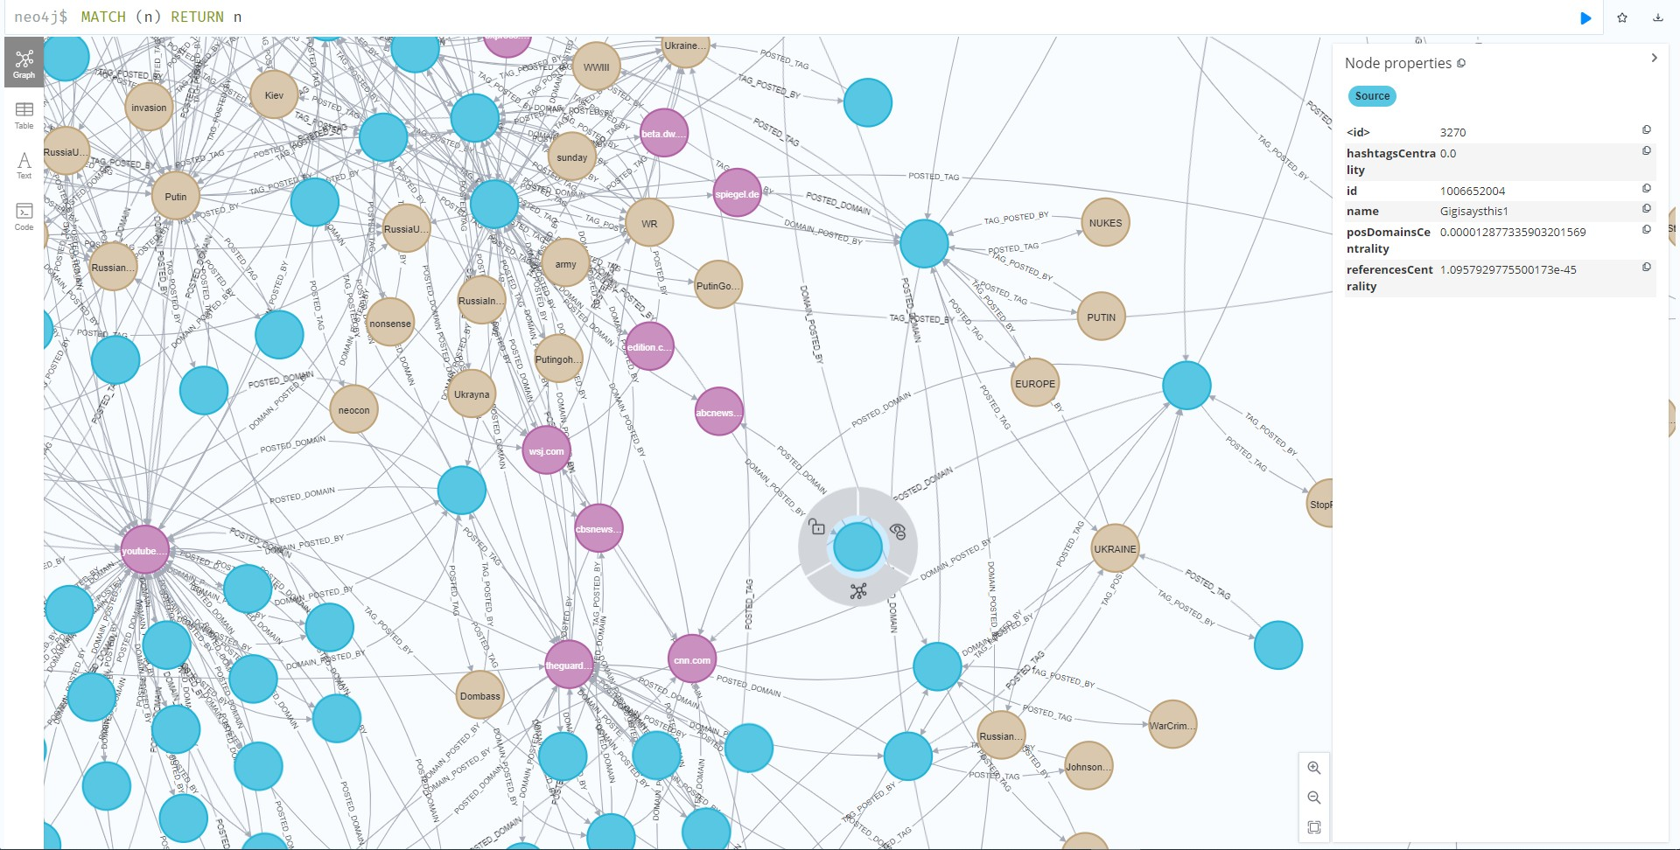
Relation Graph

Slide 11
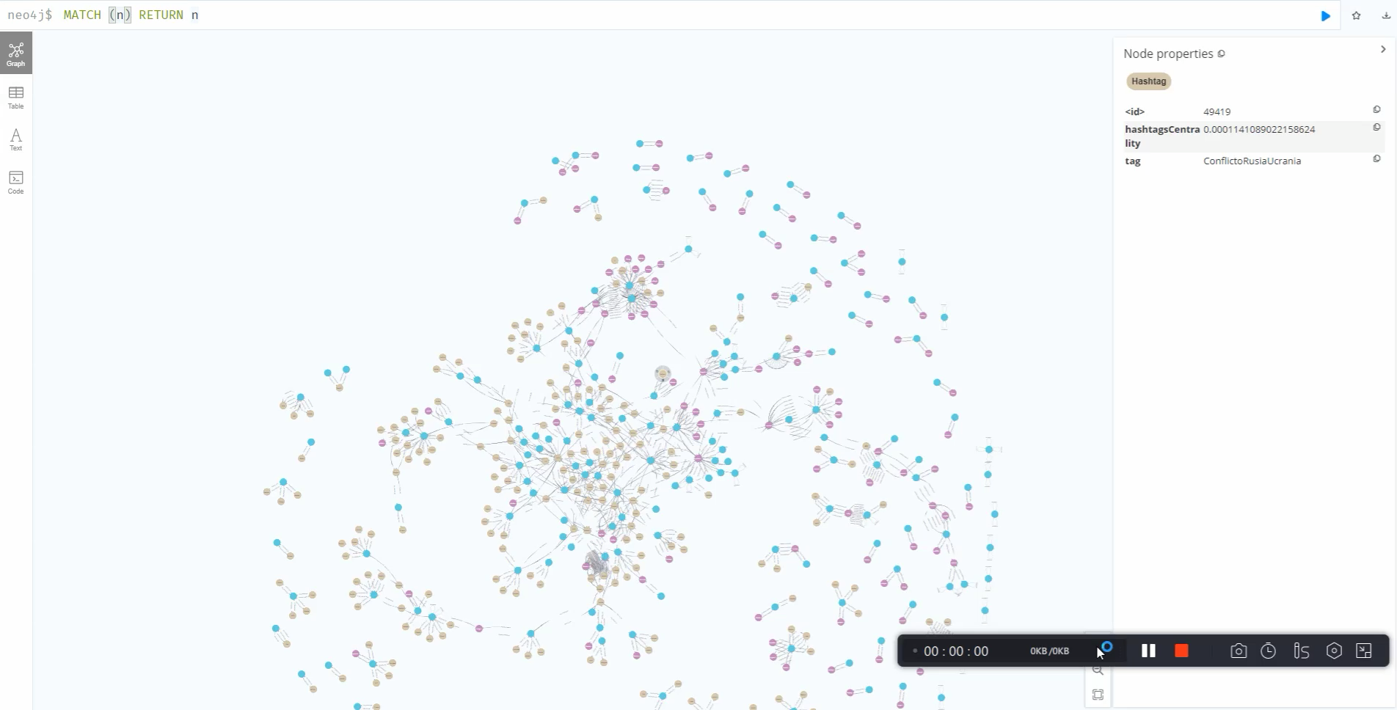
Relation Graph

Slide 12
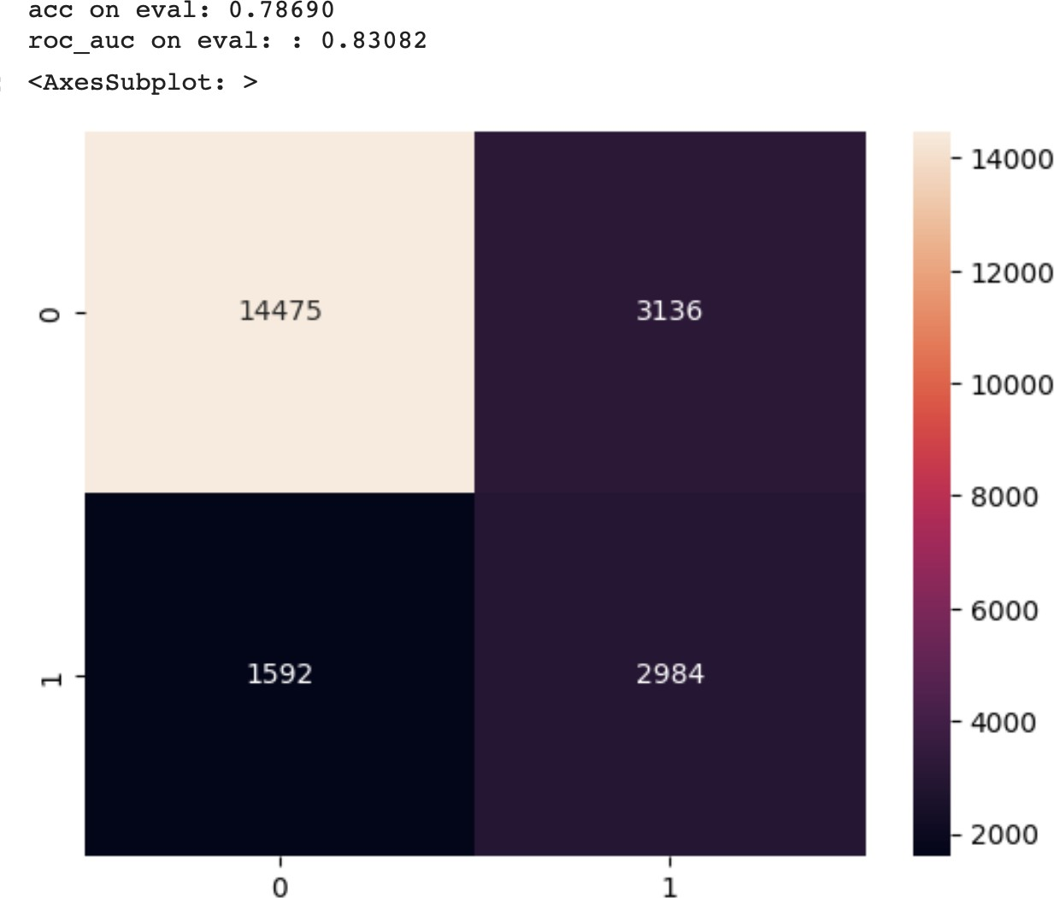
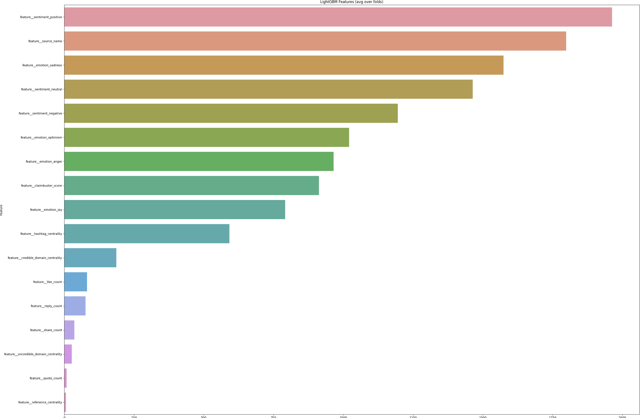
Final ML Model Results on Validation Set

Slide 13
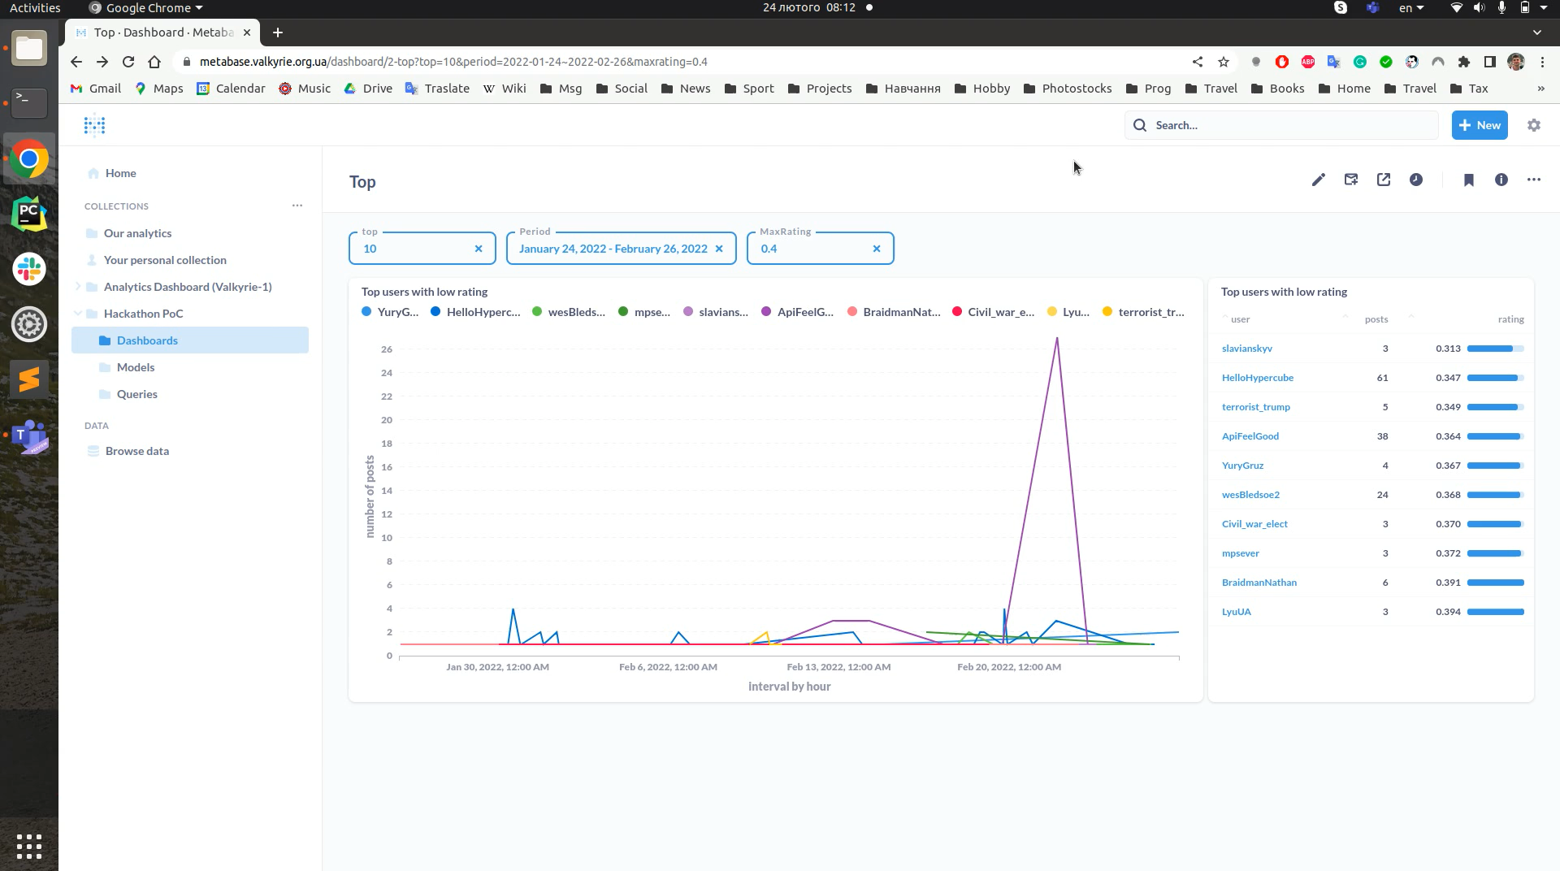
MetaBase BI Demo

Slide 14
Any Questions?

Slide 15
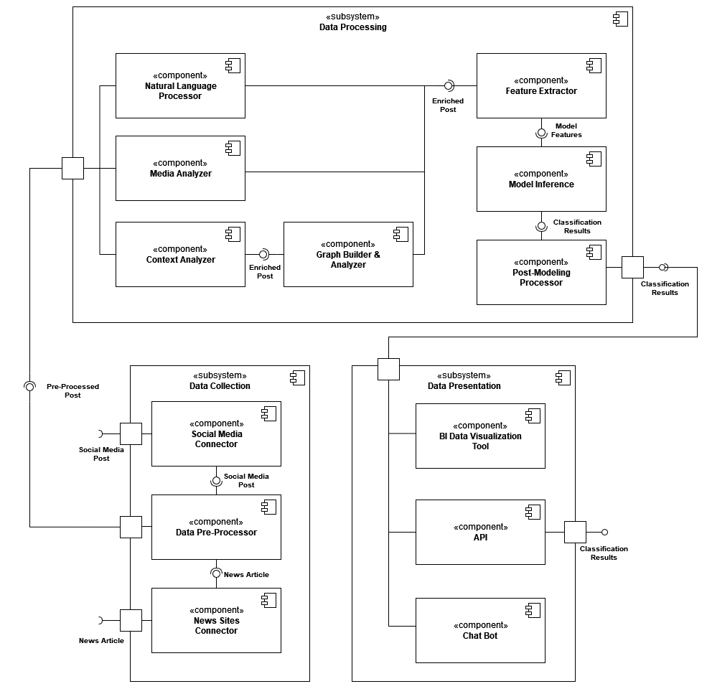
Component Diagram
PYTHON
SPACY
HUGGING FACE
CLAIMBUSTEM
GENSIM
POSTGRESQL
NEO4J
METABASE

Slide 16
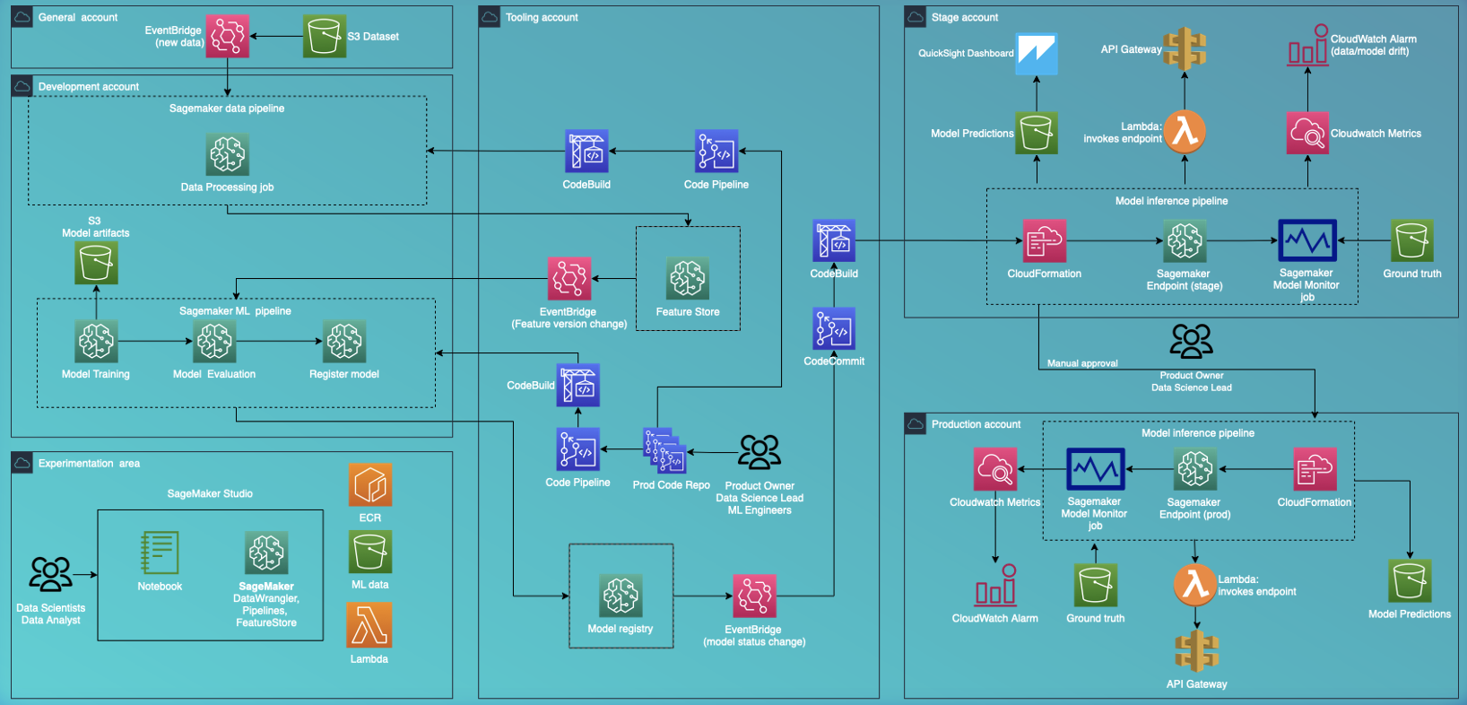
Model Lifecycle Example with AWS and Sagemaker

Slide 17







Slide 18








valkyrie.
ii
ii

Slide 20
Component Details
Model Lifecycle example with AWS and Sagemaker
applying MLOps best practices

Slide 21
Deployment Diagram
Model Lifecycle example with AWS and Sagemaker

Slide 22
High-level Architecture Steps
DATA COLLECTION
PREPROCESSING
NATURAL LANGUAGE PROCESSING (NLP)
IMAGE & VIDEO ANALYSIS
FEATURE EXTRACTION
MACHINE LEARNING MODELS
POST PROCESSING
VISUALIZATION & REPORTING

Slide 23
High-level Architecture Steps
DATA COLLECTION
PREPROCESSING
NATURAL LANGUAGE PROCESSING (NLP)
IMAGE & VIDEO ANALYSIS
Can be done using APIs provided by the platforms or third-party tools specializing in social media data collection.
The collected data must be cleaned and filtered to obtain only the necessary text, images, and video content that is relevant to the analysis.
NLP techniques, such as tokenization, POS tagging, sentiment analysis, and topic modeling can identify key topics, sentiment, tone, and language used in text content.
Can be done using computer vision techniques:
object detection
face recognition
image classification
FEATURE EXTRACTION
MACHINE LEARNING MODELS
POST PROCESSING
VISUALIZATION & REPORTING
NLP and image analysis techniques can be used to extract features that can be used for disinformation detection:
the sentiment of a post
the use of emotional language
the presence of specific objects on an image
Machine learning models trained on extracted features can classify posts as disinformation or not. They can use supervised or unsupervised learning techniques.
Post-processing techniques can refine results after post classification. Disinformation posts can be cross-checked with other sources for accuracy.
Results can be visualized and reported through dashboards or reports showing the number and types of disinformation posts and other relevant metrics.

Slide 24
High-level Architecture Steps
DATA COLLECTION
PREPROCESSING
NATURAL LANGUAGE PROCESSING (NLP)
IMAGE & VIDEO ANALYSIS
FEATURE EXTRACTION
MACHINE LEARNING MODELS
POST PROCESSING
VISUALIZATION & REPORTING

Slide 25
DisInformation Detector by Valkyrie-2
The detector is a machine learning-based system that is designed to identify dis/misinformation in social media data including:
metadata/feature extraction from text data by applying ML models
Utilize relations with graph DB
Storing metadata for analytic purposes and building the final model with PostgreSQL
Interpretability part with BI reports for cover the WHY questions
Process flow with details

